Slide 1
G1 based fUS
0812 2021

Slide 2

Simulation

Slide 3
Jianbo dataset :
time lag of first valley of rGG (phase = pi)
(1)not sensitive; (2) only reflect Vz.

Slide 4
Bingxue dataset:
Less stimulus time 5s

Slide 5
Vessel pixel
Clutter pixel
Red line: stimulus;
Blue line: recover

Slide 6
Vessel pixel
Clutter pixel

Slide 7
Method: absG1(1)-absG1(10)
* Clutter signal also decay faster given stimulus
PDI

Slide 8
Method: sum(absnG1(1:100)) ; absG1 was normalized by dividing the absG1(1)
* Clutter signal also decay faster given stimulus
PDI

Slide 9
Method: (absG1(1)-absG1(10))*vmsk
Vmsk: threshold on time mean(phase(G1));

Slide 10
Method: sum(absnG1(1:Timelag of phase pi))/
PDI

Slide 11
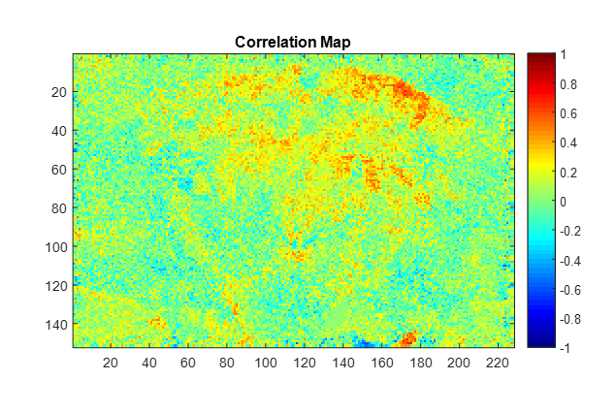
Another dataset

Slide 12
PDI results:
Further improvement
Motion rejection
PDI 16-17-500Hz-200

Slide 13
PDI results:
Further improvement
PDI svd: 50-800

